Slide 1
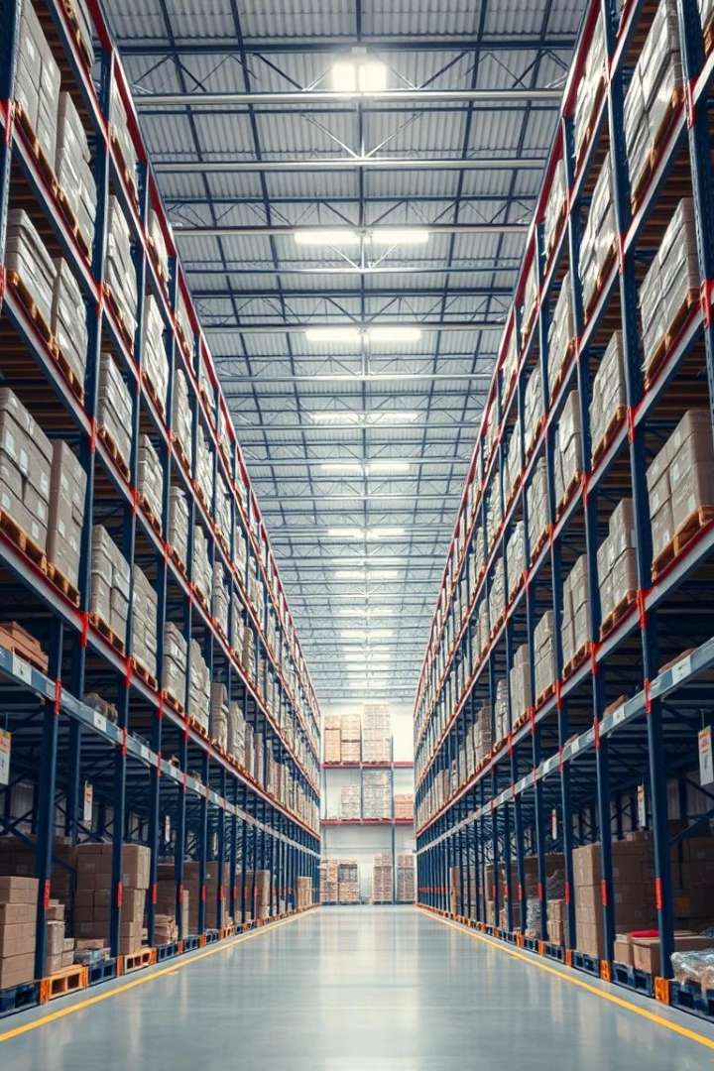

Digital Transformation for a Drug Distribution Firm Using Oracle SCM
Presented by : 1. Amr Mohamed Zaki Abdelghani
2. Khaled Khaled Moussa
3. Mohamed AbdelMaksoud Eldesouki
4. Mohamed Abdelmenaem Mohamed
5. Mostafa Ali Mostafa
6. Yusuf Tamer Abelrahman

Slide 2




What is Digital Transformation?
Digital Integration
Embedding technology into all business functions.
Operational Shift
Redefining processes and value delivery.
Cultural Change
Emphasizing automation and data-driven decisions.

Slide 3
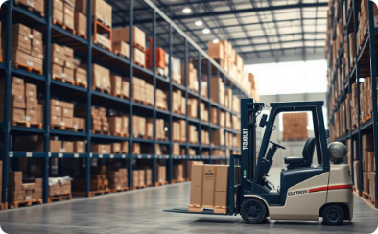


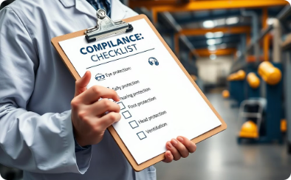
Why Digital Transformation Matters in Distribution
Inventory Control
Supplier Coordination
Order Fulfillment
Regulatory Compliance
Accurate stock visibility and management
Fast and reliable shipment processing
Real-time communication with partners
Maintains safety standards and documentation

Slide 4


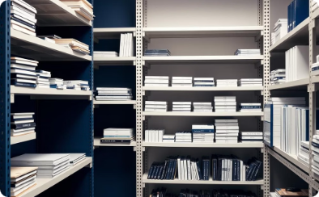

Challenges of Traditional Manual Systems
Disconnected Processes
Manual Errors
Inventory Issues
Lack of Real-Time Data
Inaccuracies and duplicate data are frequent.
Stock mismatches cause shortages or surpluses.
Departments operate in silos, lacking integration.
Information delays hinder effective decision-making.

Slide 5



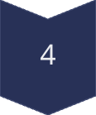


Implementation Roadmap
Process Mapping
Understand and document workflows and needs.
ERP Design
Select modules and design tailored solutions.
Configuration
Set up system according to specifications.
Testing
Validate system functionality thoroughly.
User Training
Equip users with skills for smooth adoption.
Go-Live & Support
Launch system and provide ongoing assistance.

Slide 6





Key Takeaways from the Project
Oracle SCM Fit
Team Collaboration
ERP Lifecycle
Effective for pharmaceutical distribution needs.
Hands-on experience enhances implementation quality.
Cross-functional teamwork is crucial to success.
Change Management
User training drives adoption and project impact.

Slide 7
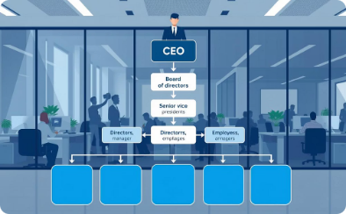
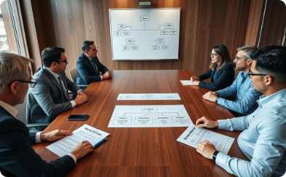
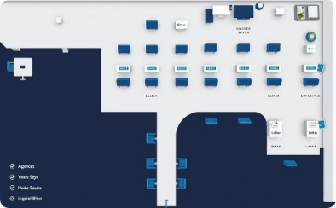
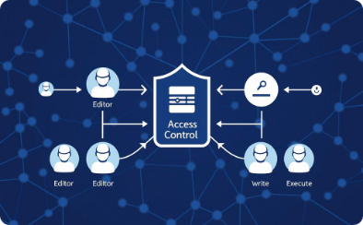
Core Configuration in Oracle SCM
Align organizational structure with company hierarchy
Create business groups, legal entities, and operating units
Set up locations, positions, and employee grades
Define responsibilities and access control levels

Slide 8
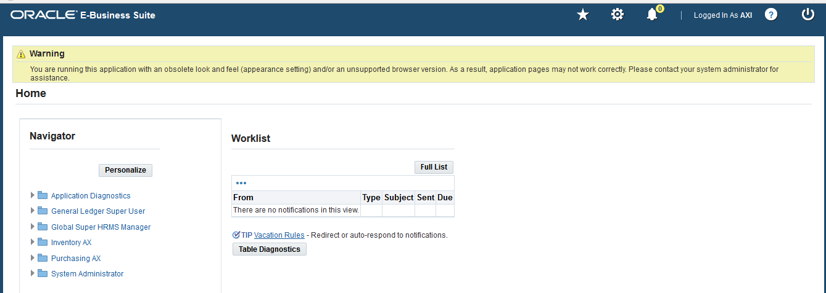
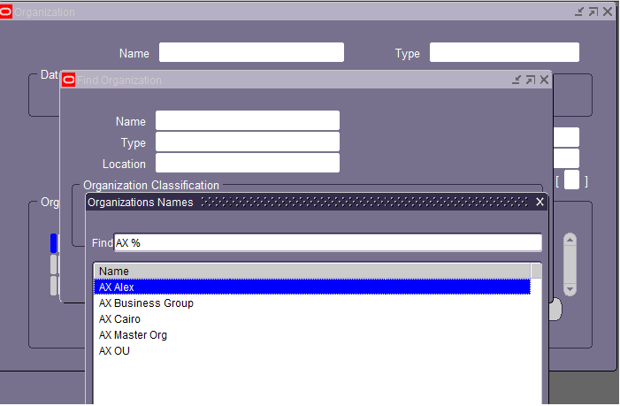
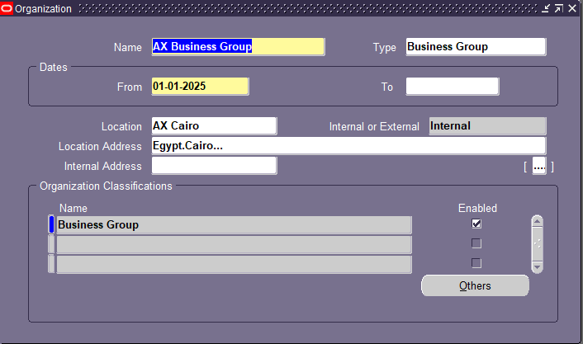
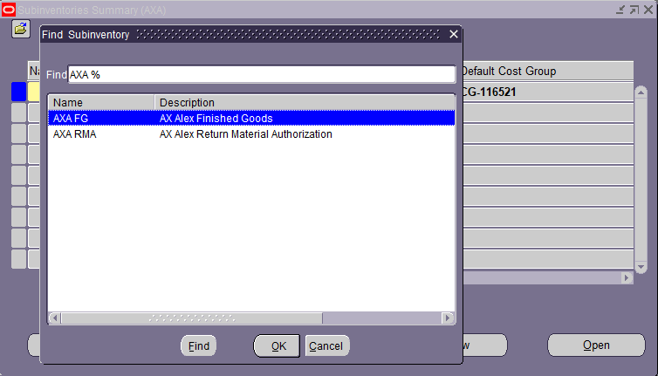
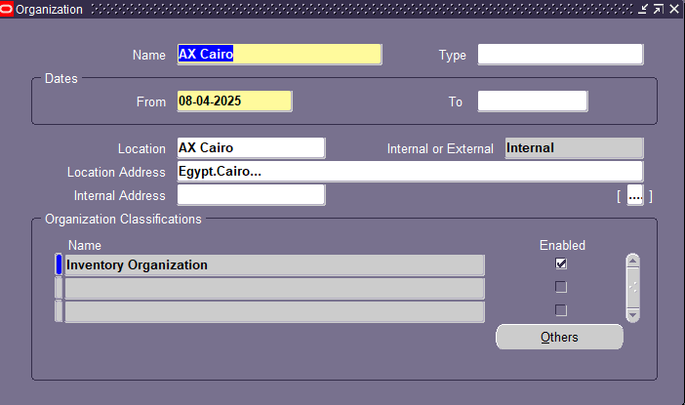
Core Configuration in Oracle SCM

Slide 9
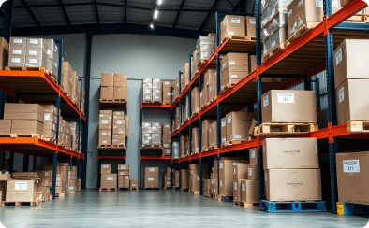
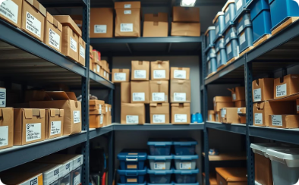
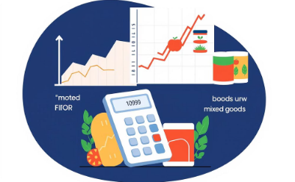

Building Inventories in Oracle SCM
Warehouse Setup
Item Definition
Inventory Controls
Traceability
Configure main warehouses and subinventories with accuracy.
Classify items using categories and standardized units of measure.
Apply costing methods to accurately track stock value.
Ensure item traceability to comply with regulatory requirements.

Slide 10
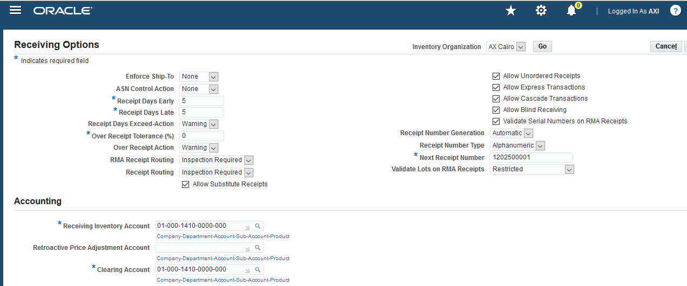
Building Inventories in Oracle SCM

Slide 11
Procurement Cycle Implementation
Supplier Setup: Create and configure suppliers and supplier sites accurately.
Requisitions & POs: Generate purchase requisitions and purchase orders efficiently.
Receipts Management: Track and update inventory upon receiving goods.
Invoice Matching: Ensure invoices align with purchase orders for accuracy.
Financial Integration: Connect procurement data with financial systems seamlessly.

Slide 12
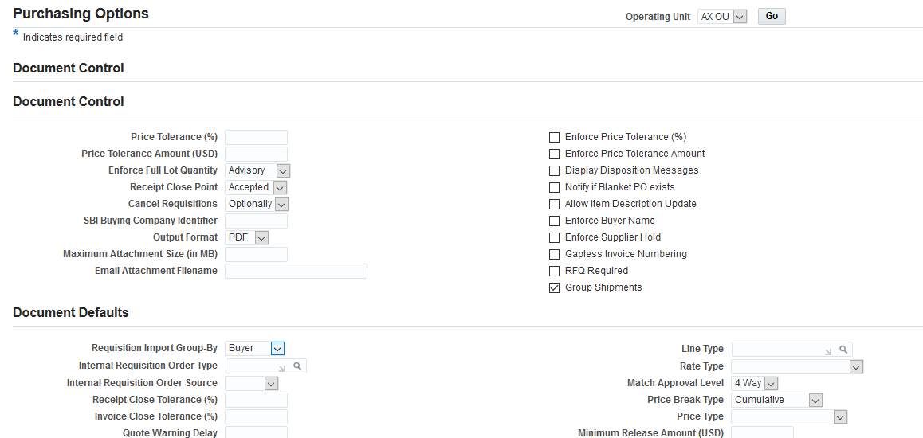
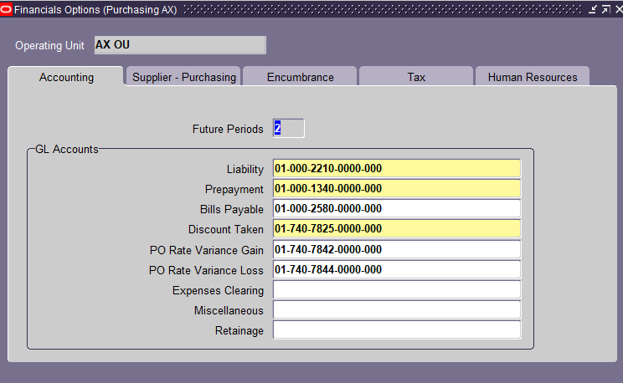
Procurement Cycle Implementation

Slide 13
Future Work and Expansion
Quality & Compliance: Implement modules to ensure regulatory adherence and product safety.
Regulatory Integration: Connect with platforms to streamline compliance reporting.
CRM Expansion: Broaden customer engagement through enhanced sales channels.
AI Analytics: Leverage AI for predictive insights and operational efficiency.

